Slide 1
Web Development
Seminar by Rachel Gardner

Slide 2
Before we begin...
Basics of a lot of topics
Ask questions!
Video and PPT will be online
Keep computer closed during instruction
Don’t panic; I’ve given you code outlines
Stick to the silly hand-raising thing to ask/answer (possibly trick) questions
Help each other!

Slide 3
The Big picture

Slide 4
What is the Internet?
The physical network of computers all over the world
Not the World Wide Web
The virtual network of websites
Connected by hyperlinks
Websites are stored on servers
Servers are computers that “serve” others by running specialized software and storing webpages
Notes:
You may have heard someone say something like "The server is down" or "We're having problems with the e-mail server." A server is a computer that "serves" many different computers in a network by running specialized software and storing information. For example, webpages are stored on servers.
When you access a webpage, your computer is acting as a client. A client runs familiar software such as web browsers or email software, and it communicates with the server to get the information it requires.
In order for your browser to display a webpage, it requests data from the server where the page is stored. The server processes the request, then sends the data to your browser, where it is displayed.

Slide 5
Servers and Clients
Server
A specialized computer that provides a variety of services
Client
A computer (or something) running a web browser or email software (or something)
Connects to the server to access the info it needs

Slide 6


Making a Connection
URL
Uniform Resource Locator
DNS
Domain Name Service
IP Address
Internet Protocol Address
Notes:
When you navigate to a website, you enter the “url” of the website into your address bar. This “url” is then looked up in the DNS records, which link the “url” to an IP address. Chrome contacts a DNS server to get the IP address

Slide 7
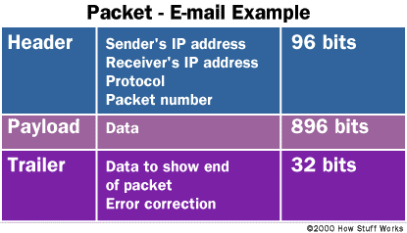
Packet Structure

Slide 8
Packet Contents
HTML
HyperText Mark-Up Language
Interpreted by the client’s browser
Either static or dynamic
Easy to write!
TCP/IP
Transmission Control Protocol/Internet Protocol
Notes:
The TCP - Transmission Control Protocol
TCP is responsible for breaking data down into small packets before they can be sent over a network, and for assembling the packets again when they arrive.
IP - Internet Protocol
IP takes care of the communication between computers. It is responsible for addressing, sending and receiving the data packets over the Internet.

Slide 9
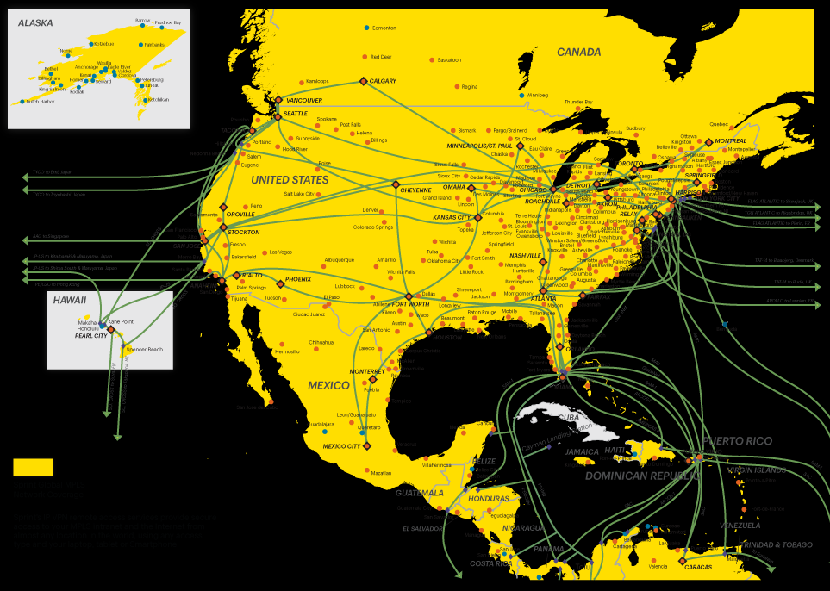
The Path of the Packets
Packets
“containers” of information
Header info gives destination, return address etc.
Routes
Vary by packet (even if the packets are going to the same place)

Slide 10
Better Packet Structure
Notes:
In the header of a packet as sort of an address within the server

Slide 11


Server Ports
Services accessible by referencing different ports, or protocols
Default is HTTP
HyperText Transfer Protocol
Port 80
Apache
Email
SendMail (Email programs talk to this)
Port 25
Notes:
In the header of a packet as sort of an address within the server; programs called servers running on the server, listening on various ports for the respective protocol of that service

Slide 12

What is Apache?
An open-source (and free) Web server software
Listens on port 80 and returns HTML to client

Slide 13
Some Common Acronyms
UDP
User Data Protocol
FTP
File Transfer Protocol

Slide 14
Linux VPS
Notes:
Times for all the way thro Linux commands

Slide 15
What is a VPS?
VPS stands for...
Virtual Private Server
Ours runs using myhosting.com
Costs ~$30/month

Slide 16
What is Linux?
A free, open-source operating system (like Windows)
Often used for development
Small, low profile OS that can be used without a GUI
Very important for a server!
Predominant “Internet-facing” OS
An OS of many flavors: Ubuntu, Mint, Debian etc.
Notes:
Technically the flavors are called distributions
Each distribution has its own die-hard fans

Slide 17
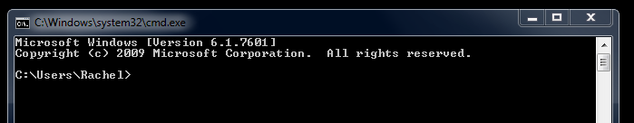
How do I talk to it?
Command line
A program to take commands from the keyboard and give them to the OS
Sort of like the Windows command line
The magic window that will appear once you connect to the server

Slide 18
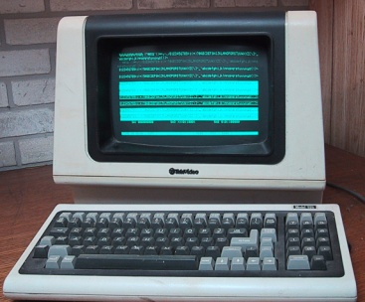
Connecting to the Server
A “virtual” terminal or terminal emulator
A “physical” terminal
A way of interacting with the shell
What is a shell?
An interface to start other programs
Provides the command line “service” to talk to the OS
In Linux, the “shell” actually refers to a command line shell

Slide 19
SSH
SSH
Secure Shell (though actually it’s a protocol)
A means by which to connect remotely to another computer
A protocol (not a shell) for how to “talk” to the server (port 22)

Slide 20
PuTTY

Slide 21
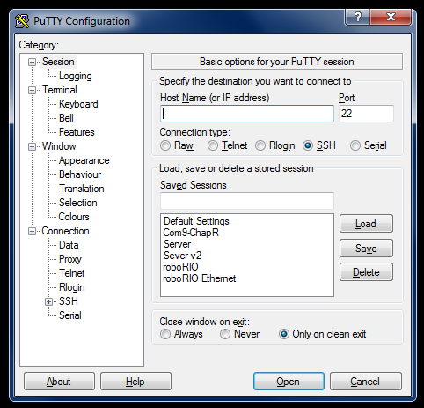
PuTTY
Free, open-source, amazing
Terminal emulator for SSHing into servers
Notes:
It can do lots of amazing things, but we’ll be using it for SSH today; walk them through connecting via PuTTY

Slide 22
Your turn

Slide 23
Objectives
Start PuTTY
Enter chapresearch.com as the host name
Notes:
It can do lots of amazing things, but we’ll be using it for SSH today; walk them through connecting via PuTTY

Slide 24

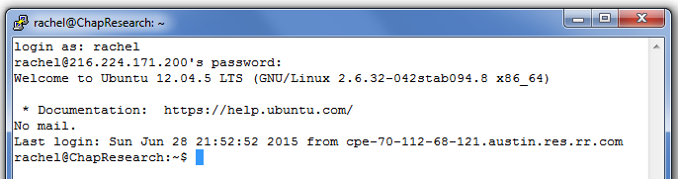
Objectives
Log in as yourself
Username: [your lowercase first name]
Password: [your lowercase first name]
Notes:
Ping is the source of the name for “lag” in video games

Slide 25
Objectives
Type in: ping google.com
Watch what happens
Hit [Ctrl]-C when finished
Notated as ^C in the shell
What just happened?
What is the IP address of google.com?
How long did it take?

Slide 26
Objectives
Type in: traceroute google.com
What just happened?
Any questions?

Slide 27
Basic Linux

Slide 28
The Basics
Each person has a “user”
Various levels of permission
Tracks who screwed everything up
Some commands executed based on location
Always have a “current directory”
user
server name
current directory
command line prompt
Notes:
Commands are executed in context of your location within the file system

Slide 29
Filepaths
Absolute
Referenced from the base directory
Begin with a forward slash (/)
Relative
Referenced from current directory
No starting forward slash (/)
Current directory => .
Move up a directory => ..

Slide 30
Basic Commands
cd [directory name or filepath]
Change directory
Ex: cd /var/www-chapresearch
Ex: cd usr
Ex: cd ..
ls ([location])
List files and directories in a location
Ex: ls
Ex: ls /tmp

Slide 31
More Commands!
man [name of command]
“manual page”
Shows a page of helpful info about the command

Slide 32
Your Turn

Slide 33
Objectives
Use PuTTY to SSH into the Chap Research server
Log in
Move “up” in folders until you find one containing “var”, then move into “var”
Find the Chap Research website’s folder within that directory
Go to the “Seminar” folder, then your folder
Verify that it contains files named after you

Slide 34
Objectives
Navigate to your webpage from the browser

Slide 35
Back to linux

Slide 36
Command Syntax
command
argument
l: “long listing”
a: “all” (including hidden)
ls -la
ls -l -a

Slide 37
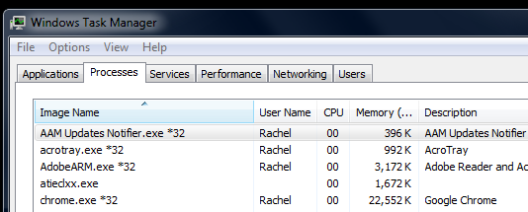
Processes
Programs running (in the background or otherwise)
Remember this?
ps
“processes”
Displays currently running processes
ps -ef
Displays more processes
e: list all f: full-format

Slide 38
More Commands
grep
global regular expression print
A search function, returning everything that matches the given regular expression
But usually you’ll just look for words
Ex: grep “chap” file.txt
Ex: grep “magic” *
cat
“concatenate”, meaning to join together
Reads files (if one arg) or joins/displays the contents of multiple files
Ex: cat file-one file-two

Slide 39
How to Escape
[ctrl]-c
Interrupts the signal
q
“quit”
[ctrl]-d
Indicates “end of file”
Also closes PuTTY!

Slide 40
To make it more complicated...
>
“Greater than”, “output redirection”
Ex: traceroute google.com > file.txt
|
“Pipe”
Makes the output of a command the input of the next command
Ex: ps -ef | grep apache

Slide 41
Examples
cat file1.txt file2.txt > file3.txt
grep “someWord” *
cat > file.txt
cat file > grep “66”
what should this be instead?
cat randomFile.txt | grep “someWord”
how can this be done better?

Slide 42
Files
Everything in Linux is treated as a file
Keyboards, USBs, printers etc.
File descriptors
A number referring to a file

Slide 43
I/O
Inputs/Outputs
stdin
“standard in”, aka the keyboard (fd = 0)
stdout
“standard out”, aka the screen (fd = 1)
stderr
“standard error”, aka error messages to the screen (fd = 2)

Slide 44
Your Turn

Slide 45
Objectives
Go to “ScavengerHunt” (in “Seminar”) to read FirstClue.txt
Get to the end of the scavenger hunt
Use Linux commands/info
Don’t cheat
Don’t use the Internet
No looking at other people’s screens
When you’re done, give cryptic hints to those around you

Slide 46
EMACS

Slide 47
Emacs
A text editor used in Linux
Created in the mid-1970’s
Designed to keep both hands on the keyboard
“Extensible/Customizable”
The competitor to VI
Run from the terminal like any program
emacs ([filename])
Can be independent of the directory

Slide 48
Navigation Commands
[ctrl]-f
Forward (aka to the right)
[ctrl]-b
Backward (aka to the left)
[ctrl]-p
Previous line (aka up)
[ctrl]-n
Next line (aka down)
Cool kids have two control keys...

Slide 49

Basic Commands
[ctrl]-x [ctrl]-s
Saves the file
[ctrl]-x [ctrl]-c
Closes Emacs
[ctrl]-x [ctrl]-f
Open another file
[ctrl]-g
Abort command
[ctrl]-?
Undo

Slide 50
Your turn

Slide 51
Objectives
Edit [your name].html to print out a message of your choice
use “Hello World” if you are uncreative or sentimental
Navigate to your webpage again to see it change
Hint: remember to refresh ([ctrl]-F5)
Bonus: open another person’s file in Emacs to spy on them

Slide 52
HTML
Special thanks to w3schools.com!

Slide 53
What is HTML?
HyperText Mark-up Language
A “language” for formatting web pages
Interpreted by your browser
Based on “tags”
Lowercase text between angle brackets (<>)

Slide 54
The Anatomy of a “Tag”
Opening tag:
<[type of tag] [attribute]=“value”>
Closing tag:
</[type of tag]>
Ex:
<form action="demo_form.asp" method="get">
...magic...
</form>
Notes:
Finite # of types

Slide 55
HTML General Example
<!DOCTYPE html>
<html>
<head>
<title>HTML Tutorial</title>
</head>
<body>
<!-- this is a comment-->
</body>
</html>
Notes:
Indent to organize

Slide 56
Basic HTML Tags
<b>
Bold
<b>Example text</b>
<h1>
Heading 1
<h1>Example text</h1>
<p>
Paragraph
<p> Example text </p>
<br>
Break
First line <br> Second line

Slide 57
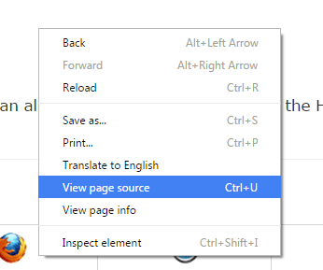
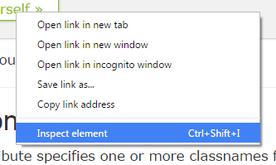
Learning Other Tags
Go to w3schools.com
Explore existing web pages
Right click and select “view page source”
Examine existing “elements”
Right click and select “inspect element”

Slide 58
Your Turn

Slide 59
Objectives
Use Emacs and [your name]-1.html on the server to...
Write something in bold
Add a heading and a paragraph (background info)
Use the resulting page to...
Examine HTML source page
Look at styling of individual elements

Slide 60
More HTML

Slide 61
Tables
<table>
<tr>
<th>1</th>
<th>2</th>
</tr>
<tr>
<td>a</td>
<td>b</td>
</tr>
</table>
1
2
a
b
*not always uniform

Slide 62
Links
<a>
Anchor
<a href="http://www.w3schools.com">Visit W3Schools.com!</a>
<img>
Image
<img src="smiley.gif" alt="Smiley face" height="42" width="42">
No closing tag!
Notes:
Href stands for hypertext reference

Slide 63
More Emacs Commands!
[Ctrl]-k
“Kill” a line of text (cut)
[Ctrl]-y
“Yank” a line of text (paste)
[Ctrl]-a
Move to the beginning of the line
[Ctrl]-e
Move to the end of the line
...do the Emacs tutorial for the rest!

Slide 64
Your Turn

Slide 65
Objectives
Use Emacs and your server webpage to...
Create a 2x2 table
Link to something
Add a picture from another website
Right click in PuTTY to paste text!

Slide 66
# systems (& colors)

Slide 67
Common Systems
Binary
Based on 2
Octal
Based on 8
Decimal
Based on 10
Hexadecimal
Based on 16

Slide 68
Example Conversions
4 | 7
10¹ = 10 | 10⁰ = 1
1 | 0 | 1 | 1 | 1 | 1
2⁵ = 32 | 2⁴ = 16 | 2³ = 8 | 2² = 4 | 2¹ = 2 | 2⁰ = 1
5 | 7
8¹ = 8 | 8⁰ = 1
2 | F
16¹ = 16 | 16⁰ = 1

Slide 69
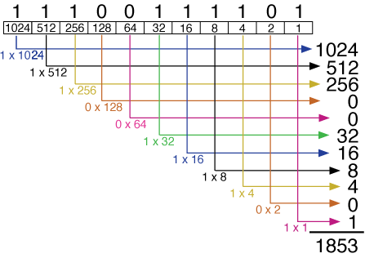
Another Pretty Picture

Slide 70
Quick Practice
# System | # | # System | #
Hexadecimal | A | Decimal
10
111
Decimal | 7 | Binary
7
Binary | 111 | Octal
27
Hexadecimal | 1B | Decimal
invalid
Octal | 8 | Binary
Binary | 1111 | Hexadecimal
F

Slide 71
Important Notes
Octal
0 – 7
1 | 0 | 1 | 1 | 1 | 1
2⁵ = 32 | 2⁴ = 16 | 2³ = 8 | 2² = 4 | 2¹ = 2 | 2⁰ = 1
0 - 15
Hexadecimal

Slide 72

How do numbers make colors?
Hexadecimal
a number system based on 16
Uses two hexadecimal digits (0 – F) to represent each part of the RGB value
RGB
Red, green, blue
The additive primary colors
#DC143C
Example color

Slide 73
Additive vs. Subtractive
Additive Colors
Made by adding color (emission of color)
Ex: colored lights (aka anything using pixels)
Red + Blue + Green = White
RGB system
Subtractive Colors
Made by subtracting colors (absorption/reflection)
Ex: painting, printing (aka anything “real”)
Cyan + Magenta + Yellow = Black
CMYK system (K stands for key, which means black because of how it’s used in printing)

Slide 74
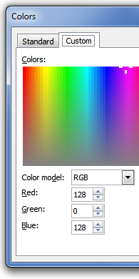
Color Practice
#000000
black
#FFFF00
yellow
#FFA500
orange
#FFFFFF
white
#800080
purple

Slide 75
CSS

Slide 76
Pretty Colors!
CSS
Cascading Style Sheets
Styling can be added to web pages in 3 ways:
Inline
Internal
External (will be covered later)
Why?
Separate content from style

Slide 77
Inline Styling
Only affects the tag it is written within
Utilizes the “style” attribute
<h1 style="color:blue">example</h1>

Slide 78
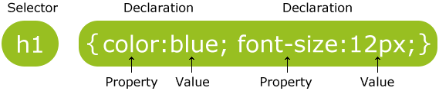
CSS Syntax
Never start a class name with a number!
Selectors:
Tag name –write the name (as above)
ID - #id
Class - .class

Slide 79
Classes vs ID’s
Class
Used to give multiple elements the same style
Many elements will have a single class
ID’s
Used to give a single element a style
Must all be unique

Slide 80
Internal Styling
Affects the entire HTML document
Uses a <style> element in the HTML <head> section
<head> <style> body {background-color:lightgrey} .fields {color:blue} #firstname {color:green} </style>
</head>

Slide 81
External Styling
Affects all pages that link to that stylesheet
<head> <link rel="stylesheet" href="styles.css">
</head>

Slide 82
What about contradictions?
Cascading
Refers to “layers” of rules
External, Internal, In-Line
Specific rules trump general ones

Slide 83
YOUR TURN

Slide 84
Objectives
Write the text in another color
Set the background color of an element
Change the font of the text

Slide 85
Javascript

Slide 86
What is JavaScript?
An extremely popular language for changing website content
Not Java
Client-side scripting language
Similar syntax though
Used for…
Makes websites more dynamic/interactive
Changing HTML without reloading a page
Changing CSS without reloading a page
Form validation
Random other cool stuff
Notes:
Design website so it doesn’t need javascript

Slide 87
How to Use
Insert a function between <script>tags
head, body, external
<p id="demo">A Paragraph</p>
<button type="button" onclick="myFunction()">Try it</button>
<script>
function myFunction() {
document.getElementById("demo").innerHTML = "Paragraph changed.";
}
</script>
<script src="myScript.js"></script>

Slide 88
Your Turn

Slide 89
Objectives
Make something happen on your HTML page with the click of a button
Use your imagination and the internet!

Slide 90
WordPress

Slide 91

What is WordPress?
A blog-oriented platform for website development

Slide 92
Why WordPress?
Easy to use
Customizable
Integrates well with user code
Lots of plug-ins available
Well documented
Runs a lot of websites

Slide 93
Your Turn

Slide 94
Objectives
Navigate to the folder containing sprocketr.php (hint: start with cd /var)
Show the detailed contents of the folder

Slide 95
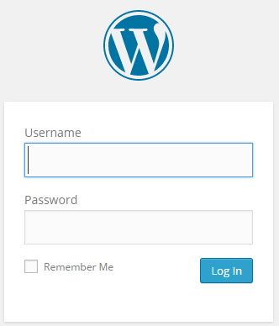
Basic Use
Navigate to [yourwebsite]/wp-admin

Slide 96
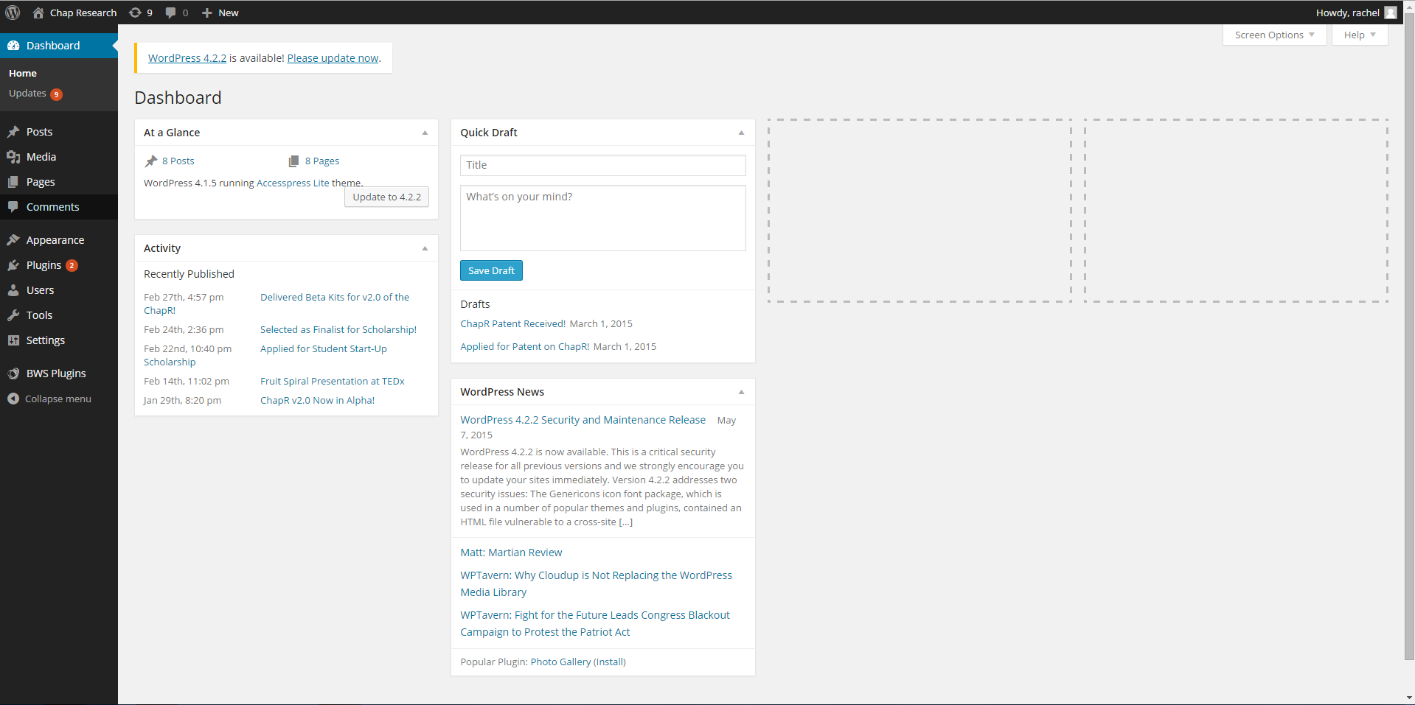
Basic Use

Slide 97
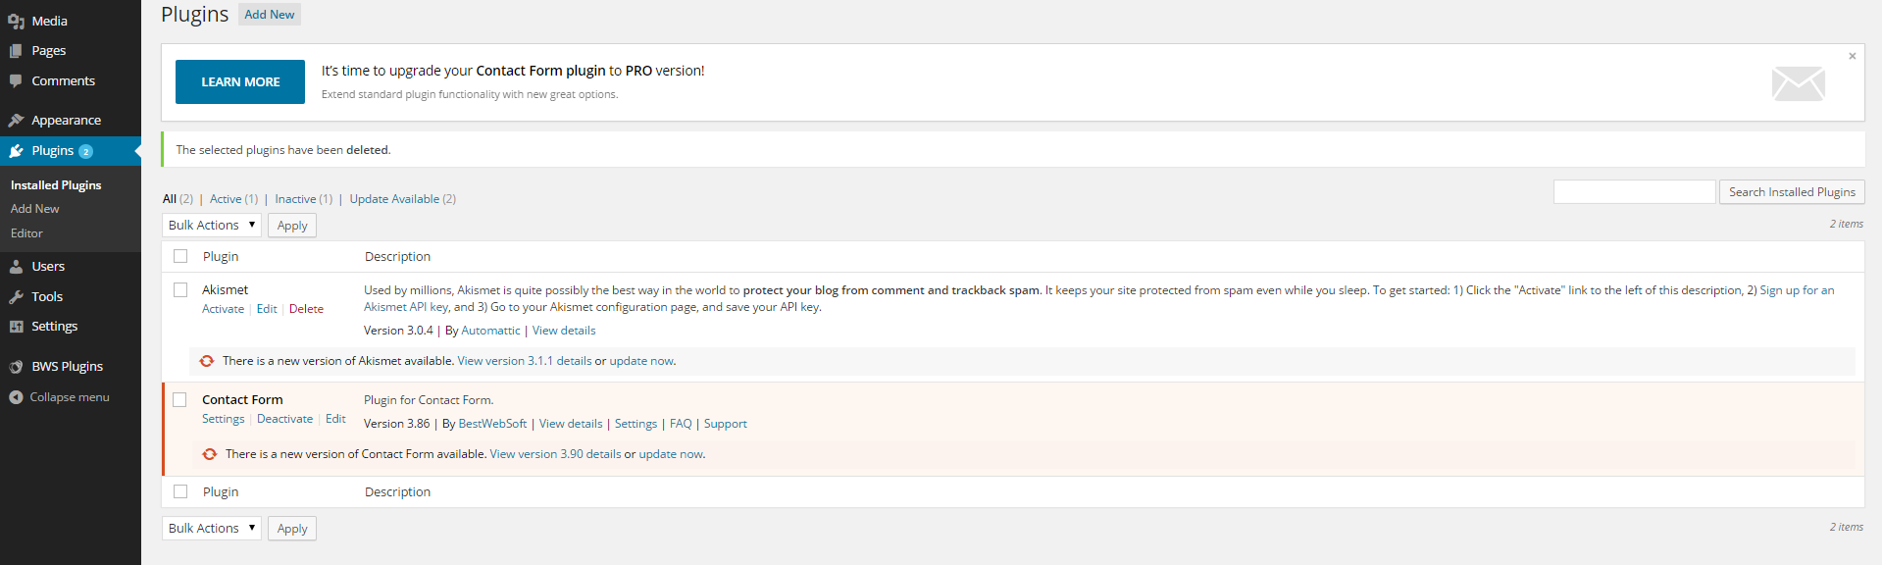
Plug-Ins
Allow for nearly infinite added functionality
Search Engine Optimization (SEO)
Forums
Automatic contact forms
Site analytics
Google map integration
Notes:
Let me know if you need the password

Slide 98
Posts vs Pages
Posts
Time-based content
Ex: newsfeed
Pages
Static content
Ex: project pages

Slide 99
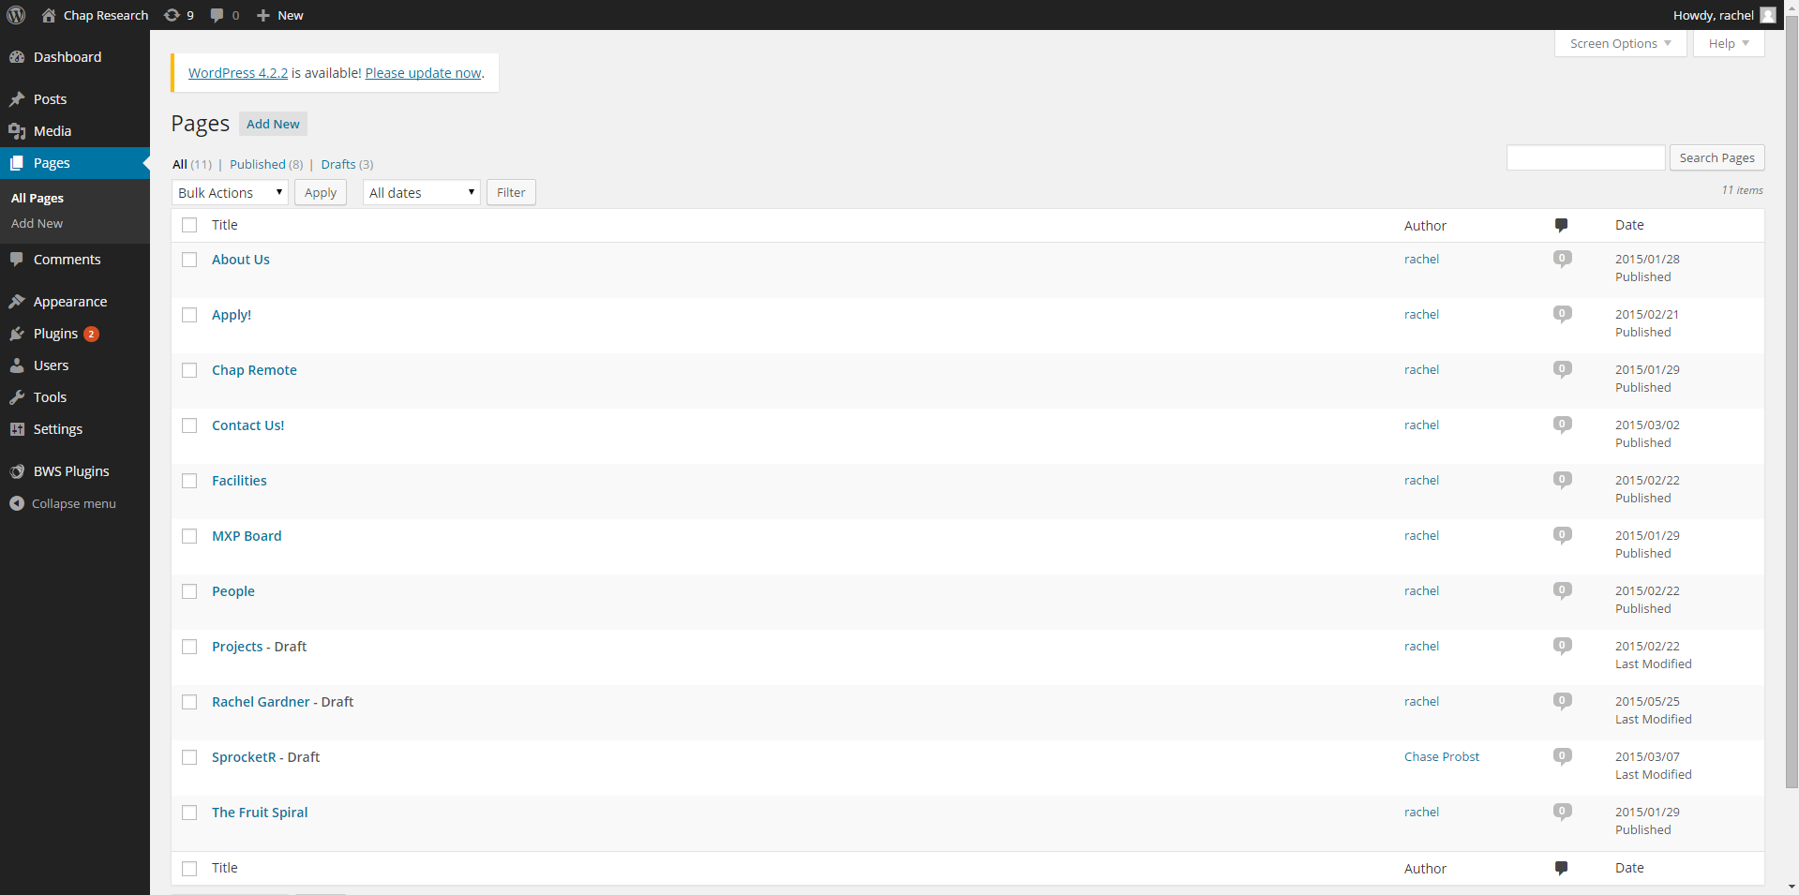
All Pages

Slide 100
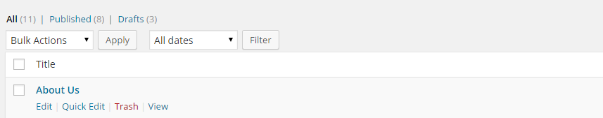

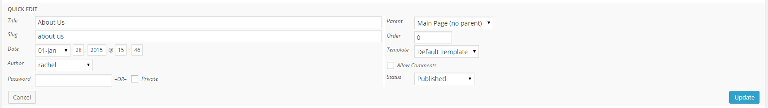
The Quick Edit Menu
URL-friendly name of page

Slide 101
Visibility
Private
Automatically “publishes” the page
Only visible on the site by users logged into WordPress
Password-Protected
Works for drafts and published pages
Requires a password to view

Slide 102
The Quick Edit Menu: Pages

Slide 103
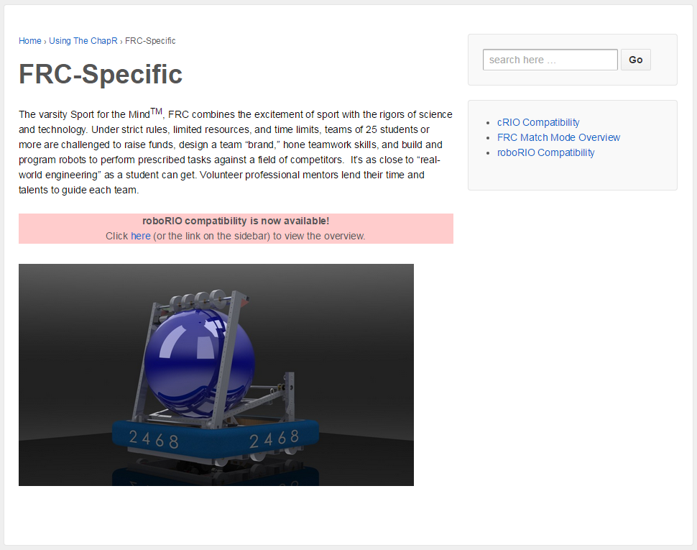
Parent Structure
Pages and subpages allow you to organize pages

Slide 104
The Quick Edit Menu

Slide 105
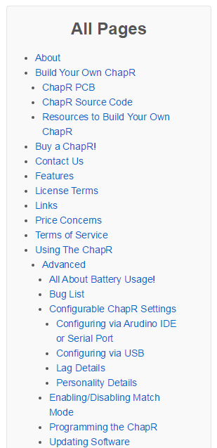
Order
Used to list pages in a particular order (as opposed to alphabetically)
Enter 1,2,3,4 etc.

Slide 106
The Quick Edit Menu

Slide 107

Templates
Used to set the general format the content will follow
Custom templates allow you to do cool stuff
Editable from Appearance->Editor

Slide 108
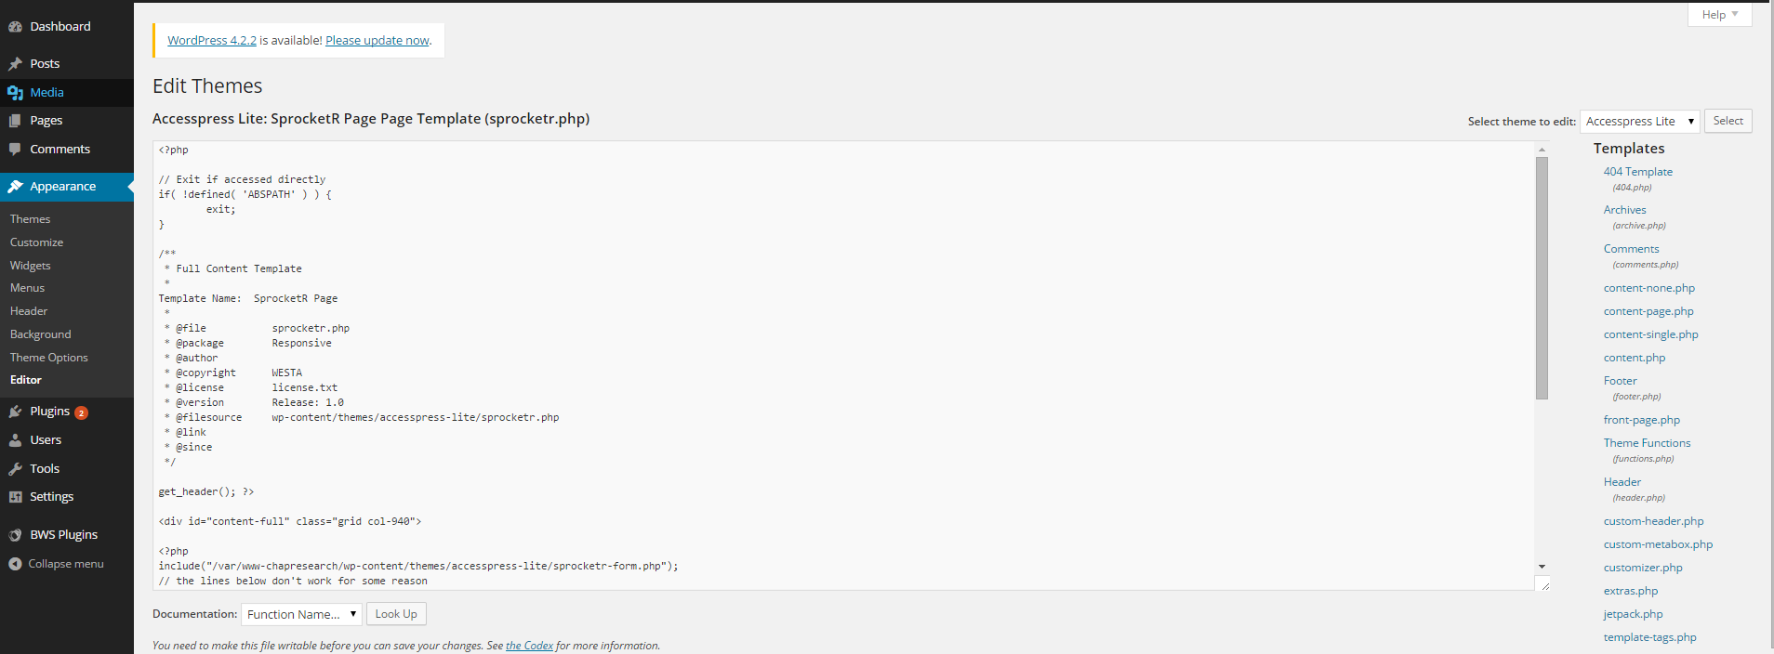
To add custom templates, copy an existing custom template and edit it to your liking
To copy a file in Linux: cp [current location/name] [destination location/name]
Ex: cp folder/file.php newfile.php
Ex: cp sprocketr.php example.php

Slide 109
The Quick Edit Menu

Slide 110
Statuses
Published
Visible to anyone on the site itself
Draft
Visible only to authorized users logged into WordPress
Seen behind the scenes
For unfinished posts/pages
Pending Review
Draft with a “pending review” flag visible from the admin area

Slide 111
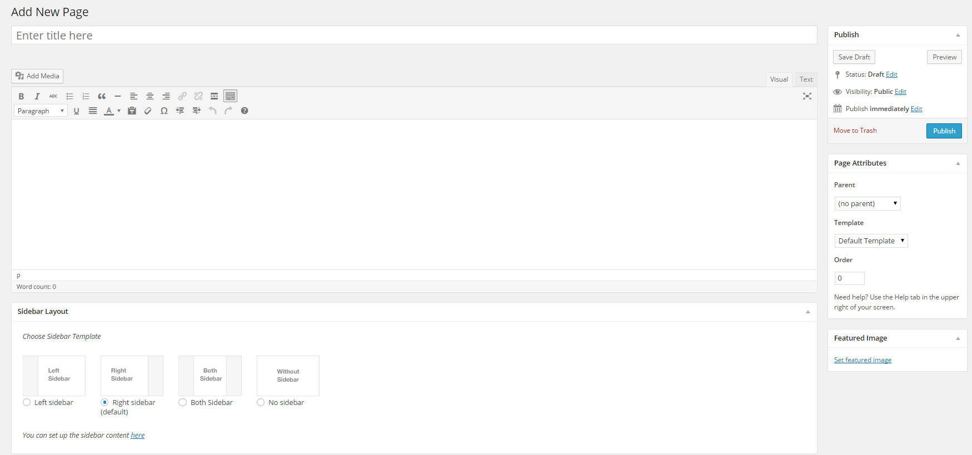
Editing & Creating Pages

Slide 112
Visual vs Text
Visual
A rough idea of what the page will look like
View the actual page to be sure!
Text
The HTML of the website
Automatically generated by the “visual tab”
Should be overwritten if you want to do anything complicated

Slide 113
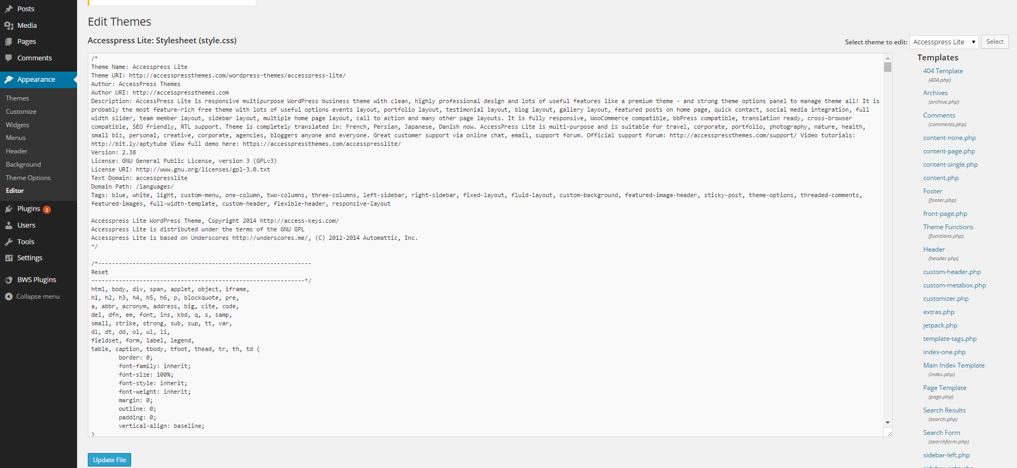
Why do I care?

Slide 114
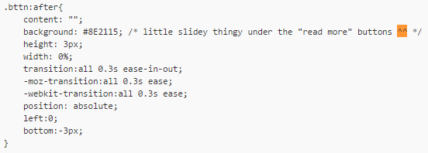
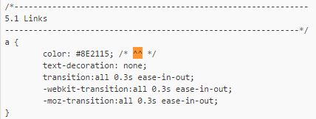
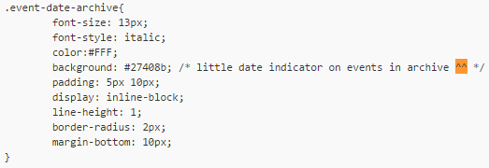
CSS Snippets

Slide 115
Your Turn!

Slide 116
Objectives
Log in to WordPress
Create a new page
Title it your name
Add a picture of yourself
Remove the sidebar from the final webpage
Link to a random page on our website (hint: see existing content section)
Publish and view the page
Leave the page on your screen and help those around you

Slide 117
Logging In
Navigate to [yourwebsite]/wp-admin
Chap Research Members:
Username: [your lowercase firstname]
Password: [same as username]
Others:
Username: guest
Password: guest
*don’t forget to check for caps lock

Slide 118
PHP

Slide 119
PHP
PHP
PHP Hypertext Preprocessor
Used to generate HTML in dynamic web pages
Alternative to other languages like Ruby
Operates “server-side”
Notes:
Brownie points if you know what PHP stands for...it’s actually a recursive abbreviation
Where have we heard “hypertext” before?
Explain dynamic webpages
Where HTML effectively the only “language” to lay out webpages, PHP has several competitiors
Explain “server-side”

Slide 120
What does it look like?
<?php
$variable = return_method();
if ($variable == value){
echo(“hi”);
} else {
echo(“bye”);
}
?>

Slide 121
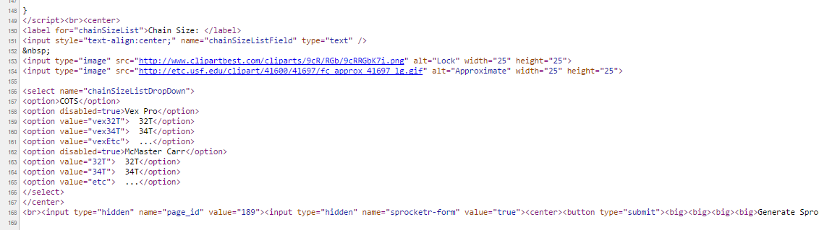
How do I check it?
HTML Source
Allows you to check/debug the HTML you generate
[Ctrl]-F is your friend!

Slide 122
YOUR TURN

Slide 123
Objectives
Create a PHP program to generate a “random” phrase based on either the time or a random number generator
Leave the program on your screen and help others

Slide 124
HTML Forms

Slide 125
General Structure: HTML
<form action=“” method=“get”>
<table frame=“void”>
<tr>
<td><p>Some prompt text</p></td>
<td><input type=“[someType]” name=“[variableName]”></td>
</tr>
<tr>
<td><p>Other prompt text</p></td>
<td><input type=“[otherType]” name=“[otherName]”></td>
</tr>
</table>
<input type=“hidden” name=“[formName]”></input>
<input type=“submit” value=“Submit!”>
</form>

Slide 126
YOUR TURN

Slide 127
Objectives
Create an HTML web form with the following in a table...
Text field (with prompt)
A drop-down menu
Submit button
*Bonus:
Change text colors
Remove the border of the table
Add checkboxes

Slide 128
PHP form processing

Slide 129
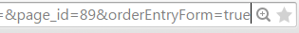
How does a form work?
“Action”
Determines where the form returns to
“” means to return to current page
A different file path or website will send the form’s data to that “landing page”
$_GET array
PHP array to store the values inputted
Each value is stored under the name of the input
Appears in the address bar when submitted

Slide 130
General Structure: PHP
<?php
function displayForm()
{
echo(“[HTML to generate here]”);
}
function displayValues()
{
// this is a comment
}
if ($_GET[“FormName”]){
displayValues();
} else {
displayForm();
}
?>

Slide 131
Single vs Double Quotes
Single quote ( ‘ )
Does not “parse”
Variables ($variableName) are not replaced by value
Double quote ( “ )
Does “parse”
Other double quotes must be “escaped”
Same in the shell!

Slide 132
YOUR TURN

Slide 133
Objectives
Create a landing page to show the data inputted (with text to explain)
*Add more kinds of inputs or some CSS if you get bored!
. => +

Slide 134
MORE LINUX!!!

Slide 135
File Information
Owner
Size
Name
Permissions
Group
Date Modified

Slide 136
Permissions
chmod [permissions] [file name]
Change mode
Ex: chmod 666 sprocketr.php
What are those numbers?!
Octal numbers
A number system based on 8, remember?

Slide 137
Practice
Permissions | Binary | Octal
All permissions
Full permissions for owner only
Only read permissions for owner, group and everyone else
111 111 111
777
111 000 000
700
100 100 100
444

Slide 138
Your Turn

Slide 139
Objectives
Log into the server
Change the permissions of your file so “everyone else” can’t read, write or execute it (but don’t change the permissions for any other user)
Navigate to your page and verify that nothing appears now
Hint: this only takes one command (or so)

Slide 140
mySQL

Slide 141
What is mySQL?
An open-source language for creating databases (a Relational Database Management System)
Runs SQL (Structured Query Language)
The language we run our databases in
A separate process running on our server

Slide 142
The grand Tour

Slide 143
Resources
w3schools.com - tutorials in HTML, CSS, PHP and JavaScript
http://computer.howstuffworks.com/internet/basics/internet1.htm - how the internet works
http://computer.howstuffworks.com/internet/basics/internet-infrastructure.htm - the infrastructure of the internet
http://ryanstutorials.net/linuxtutorial/ - ignore that part about that nasty editor called VI
http://www.gnu.org/software/emacs/tour/ - some more about Emacs (note: if you install Emacs on windows, you can get to the built-in tutorial)

